Slide 1
Presents
OO Programming with Java
OO Programming Relationships
Notes:
OO Programming Relationships
Module 8

Slide 2
Learning Objectives
Introduce more of the fundamentals of Object-Orientation (OO):
  OO Systems
  Interfaces
  Inheritance
  Polymorphism
  Association
  Abstraction

Slide 3
Relationship Primer for O-O
The two primary types of relationships in Object-Oriented Programming are:
“Is-a”
  Inheritance
  A Station Wagon is-a Car.
  Implemented as an inheritance hierarchy with one or more roots
    Base/Super/Parent classes
    Derived/Sub/Child classes
“Has-a”
  Aggregation / Composition
  A Car has-a engine
  Implemented using instance data.

Slide 4
Types of Car Objects
From the Car class we can now create as many different cars as we need.
  Each has its own speed, gasoline and engineState attribute.
Every car object we create from the Car class will have getSpeed() and setSpeed() methods.
  Business rules we place in those methods will apply to each and every car.
In Java, every object will have a reference value so that it can be uniquely identified.
Objects are often called “instances of a class” or just “instances.”

Slide 5
An Inheritance Example
Inheritance allows us to include the attributes and methods of one class in another related class.
Suppose we also need to include a Station Wagon as a type of Car.
  Station wagons need all the same attributes and methods of a Car.
  We also need to define cargo capacity and current cargo load.
Rather than copying and pasting all attributes and methods from Car to a StationWagon class, use inheritance to do this automatically.
Notes:
In Java, inheritance is accomplished by the “extends” key word.

Slide 6
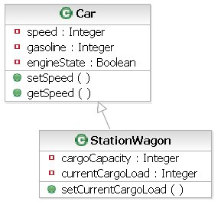
A Class Diagram
The “hollow” arrow pointing from StationWagon to Car indicates that StationWagon inherits all of Car’s attributes and methods.
We’ve included a method for setting the current cargo load. We’ll want some code to check that the load isn’t greater than the capacity.
If we create a StationWagon object and call its setSpeed() method, it is the code defined in Car that is executed.
Notes:
Inheritance is called generalization in UML.

Slide 7
Polymorphism
Polymorphism is a Greek word for “many faces”
  In Java, it means that two or more classes may have the same method name and signature but different implementations of the code.
Polymorphic behavior in Java is defined via inheritance.
  Unlike some languages, such as Python and ECMAScript, in Java, polymorphism requires inheritance.
  A parent specifies, at least, the name and signature of a method.
  All descendants of that parent inherit the declaration.
  A class that inherits that method can (re)-implement the method, as necessary, in which ever way it wants, including overriding a parent’s implementation.
Notes:
In Java, both extending a class and implementing an interface would count as inheritance. You are inheriting the method declarations, even if overriding or implementing their behavior.

Slide 8
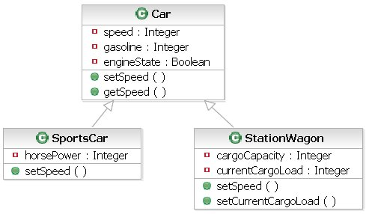
A Polymorphism Example
This diagram is discussed on the next page.

Slide 9
A Polymorphism Example
In the diagram on the preceding page, we have two classes, which both inherit from Car.
  All three classes (including Car) have a setSpeed() method.
Polymorphism allows us to create both a StationWagon called sW and a SportsCar called sC, and regard them both as though they were Cars.
  OO design principles allow us to do this because both sW and sC inherit from Car.

Slide 10
A Polymorphism Example (continued)
Polymorphism does these things:
  We can invoke the setSpeed() method on any class of type Car.
  It allows us to treat the StationWagon and SportsCar classes the same when invoking the setSpeed() method.
  And when we invoke setSpeed(), regardless of the type of Car, the code specific to that type of car will execute.
In OO programming this is extremely useful. We will cover this in much more detail in the chapter on polymorphism.
Notes:
Polymorphism allows us to group our objects by what they have in common.
Be aware that polymorphism is one of the most difficult OO concepts to understand. Don’t feel bad if this is still a little (or a lot) unclear at this point!

Slide 11
Inheritance Limitations and Alternatives
In Java, a class can inherit from only one other class.
  This is called single inheritance.
  Some OO languages allow multiple inheritance.
The designers of Java regard multiple inheritance as unnecessarily complex.
  As an alternative they offer the Interface. Java allows multiple inheritance of interface, just not of class.
  An interface is a list of methods that must be coded in any class that uses the interface.
  It ensures that all users of the interface use the same signature for the methods, and enables them to be used polymorphically.
Notes:
Imagine for a moment that you are working in a language that supports multiple inheritance. Your class C inherits from both class A and class B. Both class A and class B contain a method called myMethod. If you want to call myMethod from C you need to specify which myMethod you want – the one from A or the one from B.
In a system involving hundreds of classes, which is not unusual, this problem of determining the source of a particular method can get very complicated.

Slide 12
Interface: An Example
We need to add several more classes to our traffic system:
  We will add a CargoVan and an SUV; Both can carry cargo.
  We will also add the idea that both a SportsCar and an SUV can be a convertible.

Slide 13
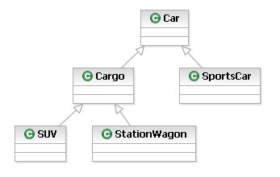
Interface Example (continued)
Leaving out the convertible for now, we’ll create this class diagram:

Slide 14
Interface Example (continued)
But how will we apply the idea of a convertible using single inheritance only?
There’s no answer that works perfectly.
  If we create a class called Convertible, we can group SportsCar and SUV under it.
  But either SUV loses the code from the Cargo class or SportsCar (inappropriately) gains it.
Notes:
Your instructor may elect to spend a few minutes sketching different solutions to this problem on the board. Of course, you can try it yourself as well.

Slide 15
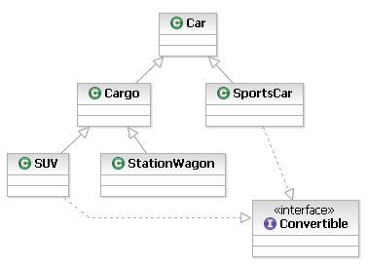
Interface Example
Instead, we create an interface and apply it to the SportsCar and SUV classes
Notes:
Interfaces allow us to apply a common set of methods to classes which are on different “branches” of the inheritance “tree.”
Remember that the interface only supplies the description of the method and requires the class itself to supply the code that actually makes the method do something.

Slide 16
Interface Example concluded
We will get into the details of writing an interface later in our class

Slide 17
Association
Association allows objects of one class to send “messages” to other objects.
  This allows an object to access the attributes and methods of other objects.
  Association is implemented by holding a reference to the other object.
For example:
  A car has an engine and an engine is a complicated “thing.”
  Engine behavior should be separate from the Car.
  The Car, however, must have a reference to its Engine; this is the association.

Slide 18
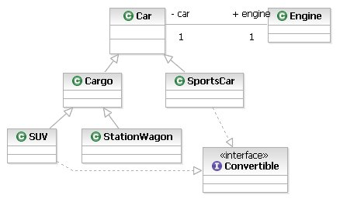
Class Diagram with Associations
In this model, every Car will have an associated Engine. Engine is now an attribute of Car
Notes:
When associative relationships are implemented into Java code, an association between two classes becomes an attribute. In the implementation of the association modeled above, Car has an attribute of type Engine and Engine has an attribute of type Car. The fact that the Car class contains an Engine attribute is what is important at this point.

Slide 19
OO Design: Constructing a Model
In OO systems, models of the classes and their interactions are often built before any coding is done.
Having a strong, carefully considered, model before writing code can avoid costly rework.
  It is easier to rework a set of diagrams than it is to rework a body of code.
Modeling allows discovery of requirements that might otherwise have gone unnoticed until late in the development process.
Often called the process of Abstraction

Slide 20
Abstraction and Inheritance
In OO programming, we often group the classes we create by how similar they are:
  We take the common characteristics of a group of similar things and place them in a separate class.
  We share, through inheritance, the similar attributes and methods across the entire group.
For example, if we had classes “FireTruck,” “TowTruck” and “PickupTruck”, we could:
  Create a superclass called “Truck,” which holds all the attributes and methods that are common to all three types of trucks.
  Create three separate classes that all inherit from “Truck.”
  Add the unique attributes and methods to each “child” class as needed.

Slide 21

Abstraction and Inheritance
Inheritance is a type of relationship between classes
Vehicle
Car
Bus
Truck
Aircraft
Sports
car
Family
car
School
bus
Van
Fire
truck
Pickup
Ambulance
Tow truck
Notes:
Inheritance allows us to reuse attributes and methods from more general classes (like Car and Truck) in more specific classes (like Family Car and Ambulance).
An ambulance “is a” Van. A Van “is a” Truck.
Van is the superclass of Ambulance. Ambulance is a subclass of Van.
In Java a class can have only one superclass but can have many subclasses.
Equivalent terms for superclass are “parent” and “base class.”
Equivalent terms for subclass are “child”, “extended class” and “derived class.”

Slide 22
Abstract Classes and Instantiation
Often the superclass is abstract. An abstract class is a class that is used as a template for other classes.
  It is the superclass for a group of related subclasses.
  Abstract classes may not be instantiated on their own.
For example:
  Make the Car class abstract and then use it as the superclass for all the different “types” of cars.
Abstract classes are covered in detail in a later chapter.

Slide 23
Generalization and Specialization
Inheritance allows generalization.
  The more general and abstract characteristics are defined in the superclass and are inherited automatically by subclasses.
  Shared characteristics are defined in one place only: the superclass.
  Each class contains only the relevant level of detail.
Specialization;
  A class adds its own characteristics to the ones it inherits.
  A class may also override (substitute) inherited characteristics.
Notes:
Inheritance in the Unified Modelling Language (UML) is called generalization, in code it is called inheritance.

Slide 24
Inheritance and Reuse
Inheritance is an obvious form of reuse.
New subclasses inherit the attributes and methods of their superclass.
New attributes and methods can be defined in subclasses.
Attributes and methods that were inherited can be modified.
Existing classes are NOT modified when inherited.

Slide 25
Finding Classes
In most projects, we start with a document defining what the system we’re building must do.
We can find candidate classes for our design via “noun-verb filtering.”
  We can begin discovering objects and attributes of objects by examining the nouns in this document.
  The verbs in the document help us discover the methods these objects will have.
We make a list of possible classes, their associated methods and attributes.
  Similarities between classes will lead to inheritance relationships.
Notes:
Some of the nouns will be classes. Some of the other nouns will be the attributes of those classes.
How to distinguish the two? If the noun can be represented in code by a simple data type like an integer or a boolean, then it’s an attribute. If it’s representation is more complex, it’s a class.

Slide 26
An Example of Finding Classes
A business document says in part:
“Our system will model traffic flow in an urban neighborhood. We must model traffic flow and parking for cars and trucks but not pedestrians or bicycles. The area to be modeled is a grid consisting of twenty streets with stop signs at some intersections and traffic lights at others. Cars and trucks must drive from point to point within the grid obeying speed limits and traffic signals.”
Take a moment to list the nouns and verbs in this description. Then group them into classes with attributes and methods.

Slide 27
Example (continued)
Nouns
  system
  traffic
  neighborhood
  area
  grid
  car(s)
  truck(s)
  street(s)
  intersection(s)
  stop sign(s)
  traffic light(s)
  parking
Verbs
  drive
  obey speed limit
  obey signals
  flow
  park
Notes:
This system will also require some class to manage the passage of time in the model. This fact is probably not obvious at first glance. As you work through the system, though, it emerges as a requirement.

Slide 28
Noun-Verb Filtering
Identify nouns in document.
  Which nouns represent the “primary elements” described in the document?
  Which nouns are “data” associated with an element, i.e., a traffic signal might have a name, a color, a setting, or other attributes named or implied by the document.

Slide 29
Noun-Verb Filtering
Identify the verbs in the document.
  Which verbs describe behavior associated with one of more of the primary elements in the document?
  Assign these verbs to the primary element the verb is acting on (e.g., A Driver would “steer” and the associated Car would “turn”).

Slide 30
Noun-Verb Filtering Good Practices
Start with the simplest scenarios
Take the time to select meaningful class names
Take the time to write a description of the class
Draw the classes on a piece of paper to get an intuitive feel for system structure
Be flexible – You will probably create and discard several versions of the system before you arrive at one that covers everything.

Slide 31
Summary
In this chapter we learned that:
  Inheritance is a way to reuse code among classes with similar functions.
  Polymorphism gives flexibility in method usage.
  Noun-verb filtering can be used to discover the classes and methods our system will need.

Slide 32
Group Exercise
Working as a group with your instructor your task is to:
  Discuss the needs of a banking software system that will manage bank accounts
    What are the types of accounts that will be needed?
    What data needs to be tracked?
    What methods are needed to manage these accounts?
    What classes does this system translate to?
    Can inheritance be used to facilitate re-use?
  White-board a solution to this system as a group discussing the pros and cons of the different alternatives that are available

